Slide 1
Introduction

Slide 2
Do U know?
Nobel prize related to computer system?
What is Principle of Equivalence of Hardware and Software?
What is multiple core device?
Is processor and core are differ?

Slide 3
Fundamental Aspects
Differentiate Computer Organization and Architecture.
C.O:-
User’s point of view
Study from s/w point of view
Eg. Car, How can be used? Drive?
C.A:-
Designer’s point of view
Study from h/w point of view
Eg. Car, How can be implemented? Repair?

Slide 4
Root of computing
Data path
Control signals
Started with numbers.
Processing the numbers.
Any computing system,
Processor- process data
Memory- store data
I/O- user interacts with system (extended memory for real data)
CPU
address
data
MEMORY
memory
storage

Slide 5
Structure and Function
Structure:- The way in which the components are interrelated.
CPU:- Registers, ALU, Control unit, Buses
Memory
I/O
Function:- Function is the operation of individual components as part of the structure
Data processing
Data storage
Data movement
Control

Slide 6
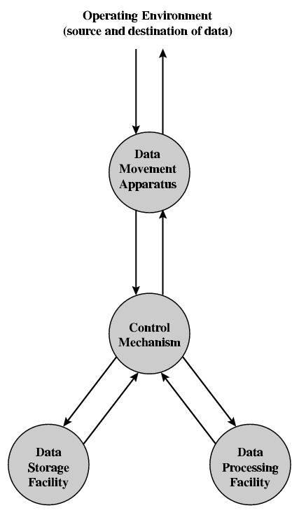
Functional view

Slide 7
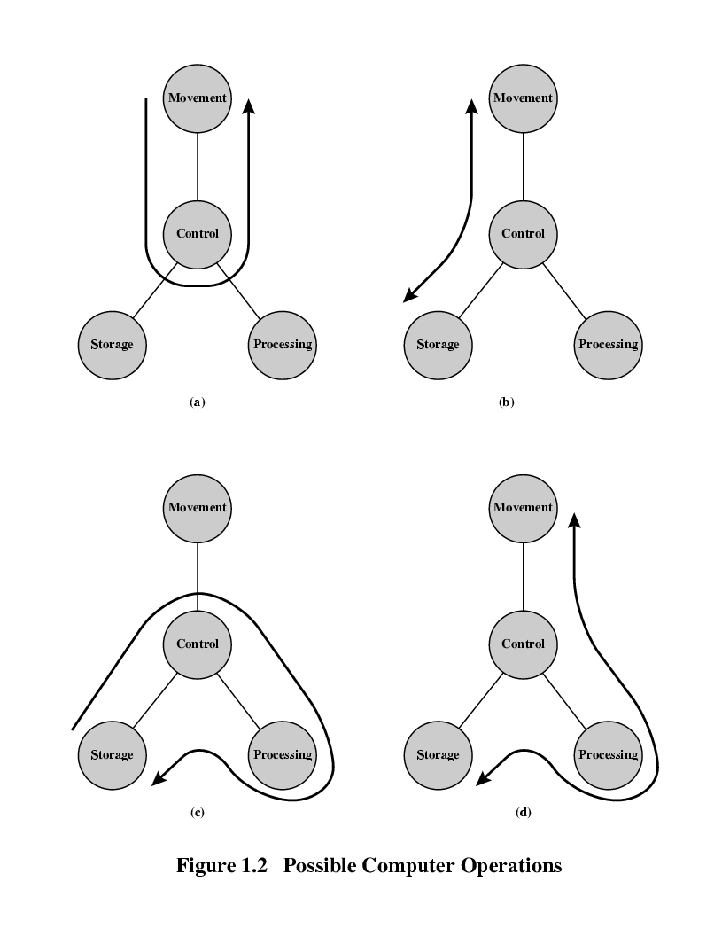
Operations (1) Data movement

Slide 8
Operations (2) Storage

Slide 9
Operation (3) Processing from/to storage

Slide 10
Operation (4) Processing from storage to I/O

Slide 11
Structure - Top Level
Peripherals
Computer
Central
Processing
Unit
Main
Memory
Computer
Systems
Interconnection
Input
Output
Communication
lines

Slide 12
Structure - The CPU
CPU
Computer
Arithmetic
and
Login Unit
I/O
Registers
System
Bus
CPU
Internal CPU
Interconnection
Memory
Control
Unit

Slide 13
Structure - The Control Unit
Control Unit
CPU
ALU
Sequencing
Logic
Internal
Bus
Control
Unit
Control Unit
Registers and
Decoders
Registers
Control
Memory

Slide 14
Fundamental Aspects
I/O process:- data from/to the local device, which is directly connected to the computer.
Data communication:- data from/to the remote device.
Application spectrum: how effectively a system can be used?
MP
Control application
Electrical engg
Special purpose
H/W oriented
ROM
Data processing
Computer scientists
General purpose
S/W oriented
RAM

Slide 15
Computing and Communicating
Numbers
Symbols
Text
Graphics
Audio
Video
multimedia
Computing
Numbers→ Arithmetic processing
Symbols→ Logic processing
ALU→ core of CPU.
Communicating
Line communication
Voice communication
Voice + coded data

Slide 16
H/W and S/W
H/W:- core of the system, hard to understand.
S/W:- soften the hard aspects of the system.
LLL
ALL
HLL
Translator:- Compiler, Interpreter, Assembler
? What is device driver?
? Differentiate System S/W and Application S/W. Give some eg.
? Example for each translators.

Slide 17
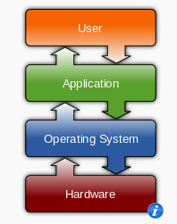
Operating System
Manages computer hardware resources.
Provide platform for
Application software.
It’s a system software.
Interface between application and the hardware.
? What are the popular modern operating systems?
? Is single processor with multiple OS possible?

